Slide 1
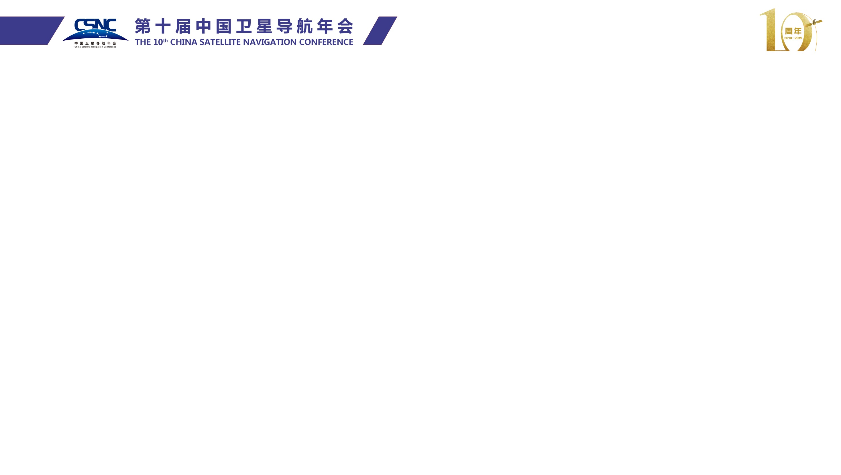

Zida Wu
I'm a second-year Master student at Electronic and Telecommunication in Shanghai Jiao Tong University. Previously, I completed my Bachelor degree at Telecommunication in Xidian University, Xi’an. My interests are multi-sensor fusion navigation, pose estimation and GNSS double difference positioning algorithm based on low-cost devices.
此处放照片

Slide 2

Pseudorange Double Difference and PDR Fusion Algorithm Using Smartphone GNSS Raw Measurements
Zida Wu
Shanghai Jiao Tong University

Slide 3
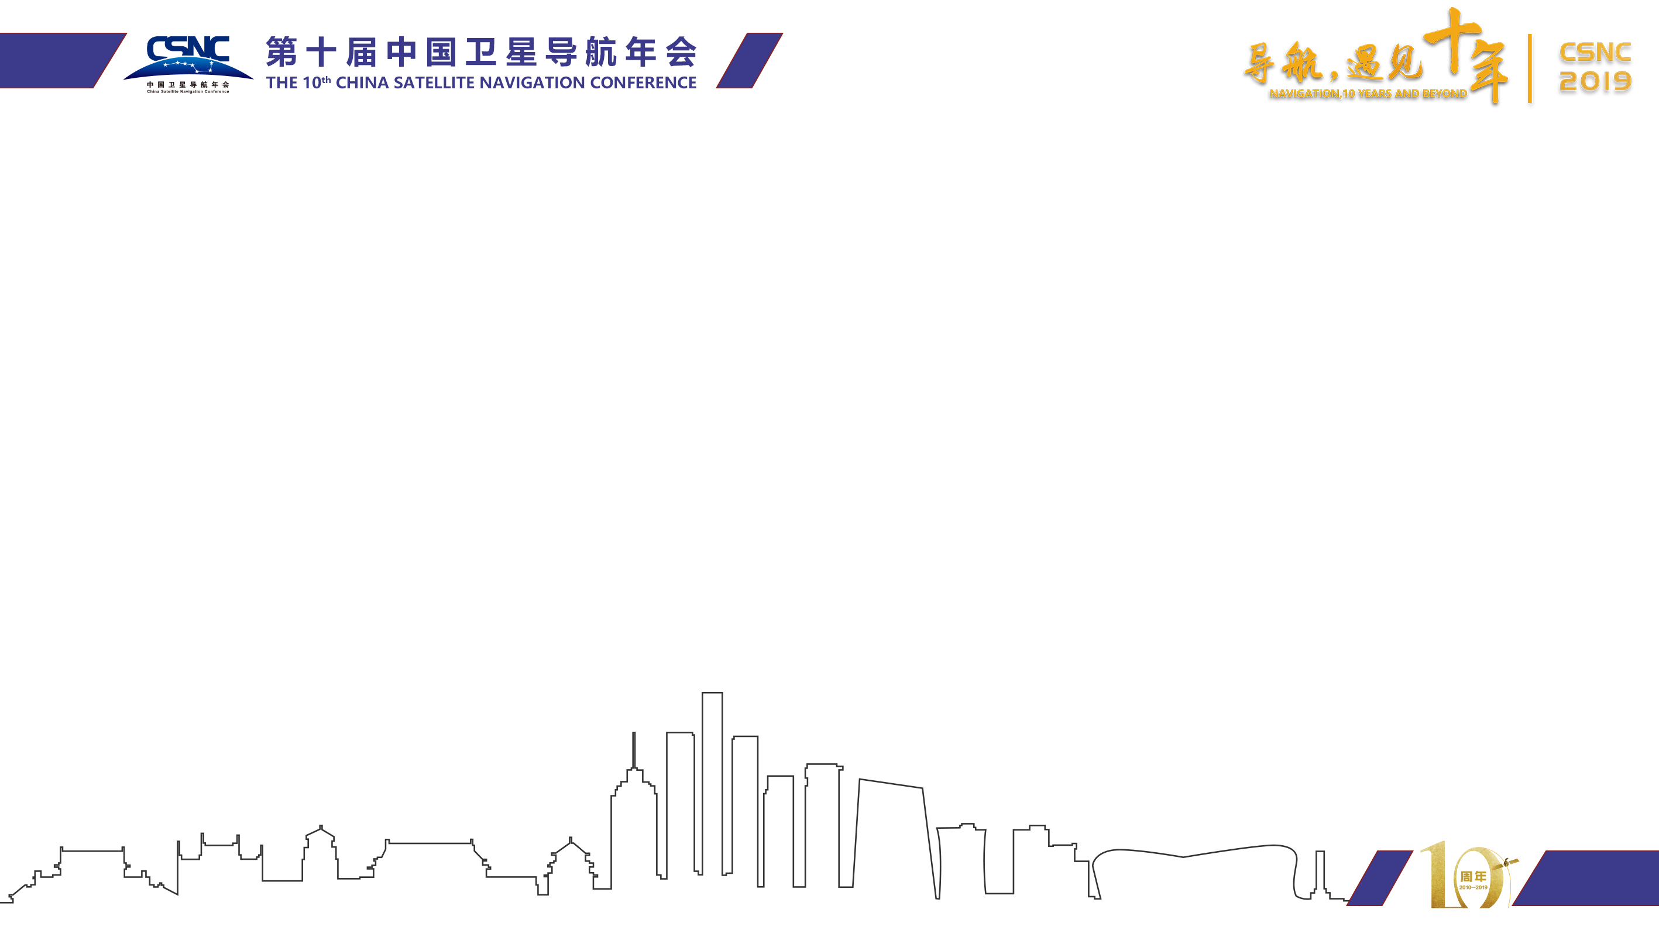
1
Background
2
PDR/GNSS Fusion Framework
3
Experimental Results
4
Conclusion

Slide 4
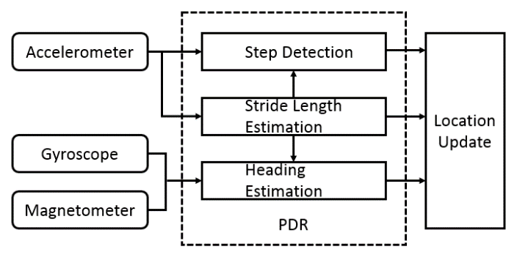
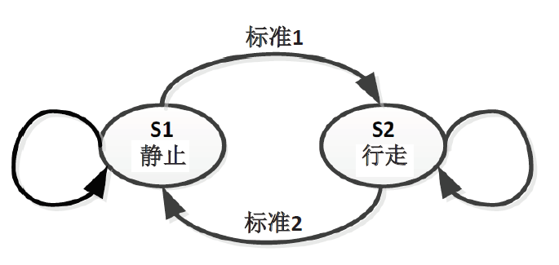
Background
The drift and instability of the smartphone IMU is the most important factor restricting the inertial navigation of the mobile phone. The PDR algorithm used the known human motion model to calculate the dead reckoning, which can dramatically improve the applicability of the IMU. Considering the open bottom GNSS primitive observation of Android, it makes possible to make pseudorange difference algorithm for intelligent terminals, and differential GPS has better advantages in terms of linearization state estimation in noise elimination, and differential GPS without cumulative errors, providing a correction in providing initial values and long-term position estimates. Based on the characteristics of the two positioning modes, this paper proposes a fusion algorithm based on PDR and differential GNSS for real-time indoor and outdoor seamless positioning.
<10km
Basic PDR framework
Difference GNSS based on short-line hypothesis

Slide 5
1
Background
2
PDR/GNSS Fusion Framework
3
Experimental Results
4
Conclusion

Slide 6
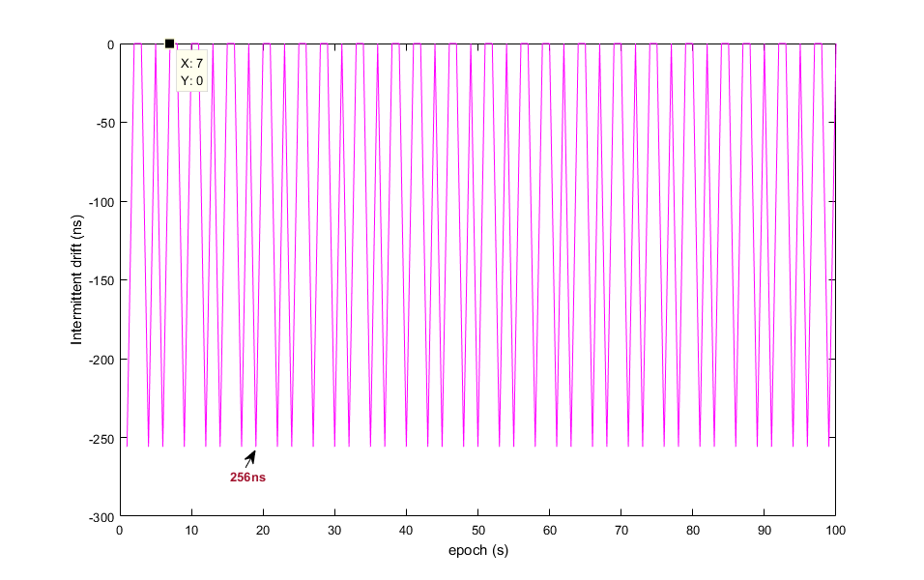
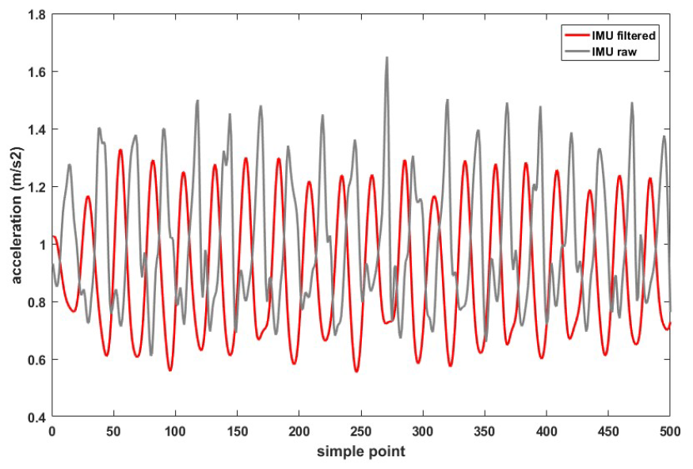
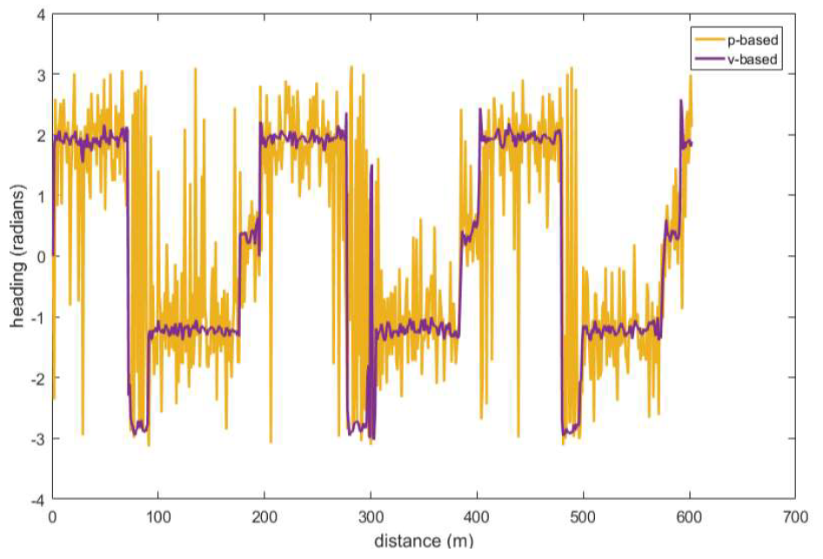

Raw data processing and GNSS heading estimation
Exist an Intermittent fixed drift: 256ns
IMU滤波前后数据
IMU data result through Filter
Two GNSS heading estimation comparison

Slide 7
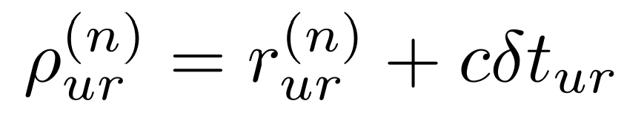
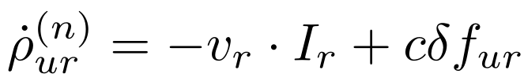
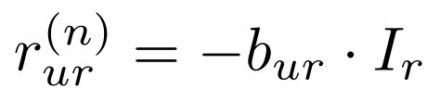
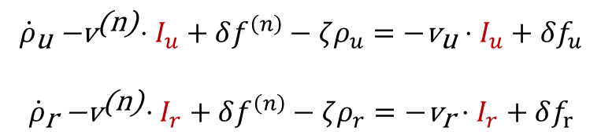
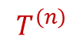
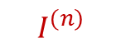


GNSS difference equation
Pseudorange
$$I^{\left(n\right)}$$
$$T^{\left(n\right)}$$
Doppler
$$I_{r}$$
$$\begin{matrix}\begin{aligned}ρ_{u}^{\left(n\right)}=r_{u}^{\left(n\right)}+δt_{u}−δt^{\left(n\right)}+I_{u}^{\left(n\right)}+T_{u}^{\left(n\right)}+ξ_{ρu}^{\left(n\right)} \\ −\end{aligned} \\ ρ_{r}^{\left(n\right)}=r_{r}^{\left(n\right)}+δt_{r}−δt^{\left(n\right)}+I_{r}^{\left(n\right)}+T_{r}^{\left(n\right)}+ξ_{ρr}^{\left(n\right)}\end{matrix}$$
$$\begin{matrix}\begin{aligned}{\dot{ρ}}_{\text{u}}{\text{−}\text{v}}^{\text{(}\text{n}\text{)}}⋅I_{u}+δf^{\left(n\right)}−ζρ_{u}=−{\text{v}}_{\text{u}}⋅I_{u}+δf_{u} \\ \end{aligned} \\ {\dot{ρ}}_{\text{r}}{\text{−}\text{v}}^{\text{(}\text{n}\text{)}}⋅I_{r}+δf^{\left(n\right)}−ζρ_{r}=−{\text{v}}_{\text{r}}⋅I_{r}+δf_{r}\end{matrix}$$
subtract
subtract
Common mode errors are calculated together
Linearized the observation vector, extend kalman filter is no more needed.

Slide 8
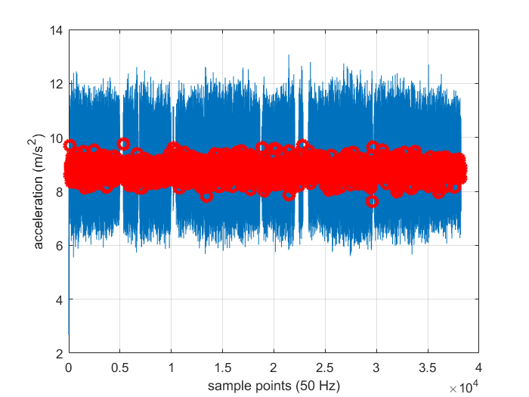
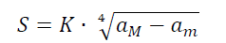
PDR algorithm
Step1：Gait detection
Peak detection algorithm on gait
Step2：Gait length detection
K is a constant factor, aM is the peak value of accelerometer, and am is the minimum.
Step3：Heading estimation
Adopt the Madgwick pose estimation algorithm to obtain the pose, which utilizes the accelerometer and gyro data to construct a error function in ENU axis, uses gradient descent way to calibrate the R, Q and Yaw angle.

Slide 9
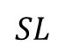
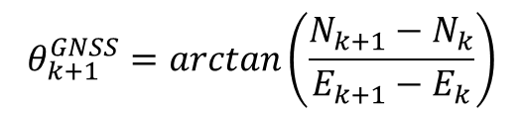
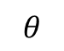

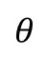
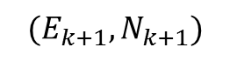
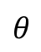
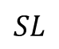
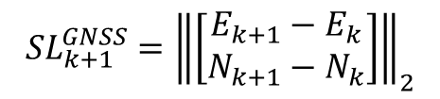
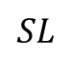
GNSS Heading & Stride Length
$$(E_{k+1},N_{k+1})$$
GNSS Heading
GNSS
$$(E_{k},N_{k})$$
$$θ_{k+1}^{GNSS}=\arctan\left(\frac{N_{k+1}−N_{k}}{E_{k+1}−E_{k}}\right)$$
Output with Fixed Frequency
$$θ$$
GNSS Stride Length
$$θ$$
PDR
$$θ$$
$$SL$$
$$SL$$
$${SL}_{k+1}^{GNSS}={\left\|\left[\begin{matrix}E_{k+1}−E_{k} \\ N_{k+1}−N_{k}\end{matrix}\right]\right\|}_{2}$$
Output with Non-Fixed Frequency
$$SL$$

Slide 10
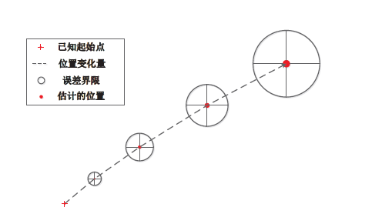
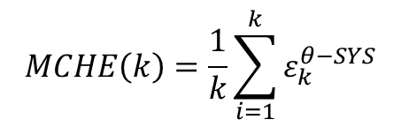
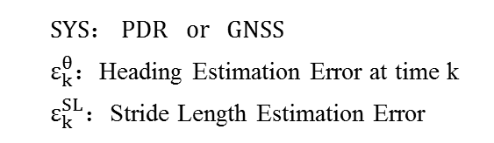
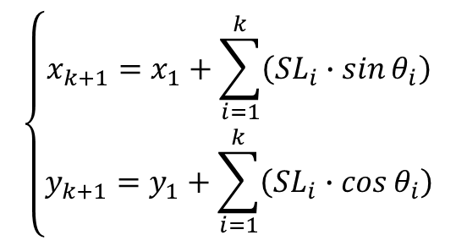
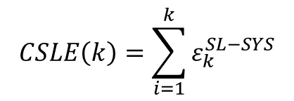
Error of Heading & Stride Length Estimation
Estimation Error is accumulated during iteration!
Two criteria：
Mean Cumulative Heading Error
$$\left\{\begin{matrix}x_{k+1}=x_{1}+\sum_{i=1}^{k}{\left({SL}_{i}∙\sin{θ_{i}}\right)} \\ y_{k+1}=y_{1}+\sum_{i=1}^{k}{\left(SL_{i}∙\cos{θ_{i}}\right)}\end{matrix}\right.$$
$$MCHE\left(k\right)=\frac{1}{k}\sum_{i=1}^{k}{ε_{k}^{θ−SYS}}$$
Cumulative Stride Length Error
$$CSLE\left(k\right)=\sum_{i=1}^{k}{ε_{k}^{SL−SYS}}$$
Accumulated Error of PDR
Another Equations of PDR
SYS： PDR or GNSS
$ε_{k}^{θ}$：Heading Estimation Error at time k
$ε_{k}^{SL}$：Stride Length Estimation Error

Slide 11
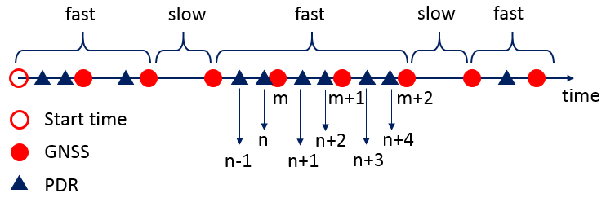
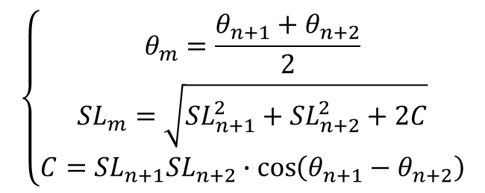
Data Synchronization
fast step：at least one complete step can be completed within 1s
slow step：one complete step cannot be completed within 1s
The basic idea of the data synchronization is to turn the data of PDR into a timing output, just like the output of GNSS.
$$\left\{\begin{matrix}θ_{m}=\frac{θ_{n+1}+θ_{n+2}}{2} \\ \begin{matrix}{SL}_{m}=\sqrt{{SL}_{n+1}^{2}+{SL}_{n+2}^{2}+2C} \\ C={SL}_{n+1}{SL}_{n+2}∙\cos\left(θ_{n+1}−θ_{n+2}\right)\end{matrix}\end{matrix}\right.$$
Data synchronization between
PDR and GNSS
n：step n of PDR
m：time m of GNSS

Slide 12
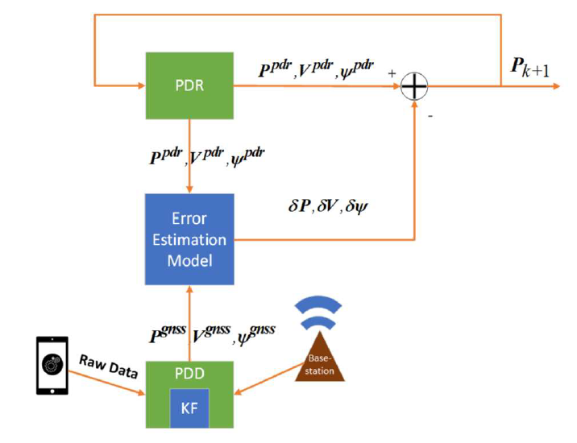
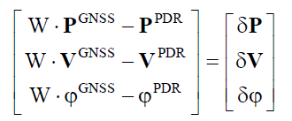
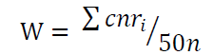
Fusion Framework
Dynamic weight
PDR and GNSS fusion algorithm

Slide 13
1
Background
2
PDR/GNSS Fusion Framework
3
Experimental Results
4
Conclusion

Slide 14
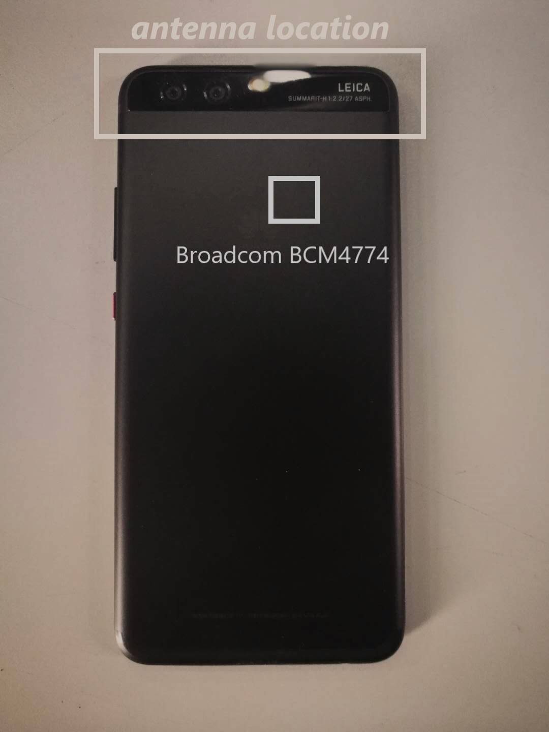
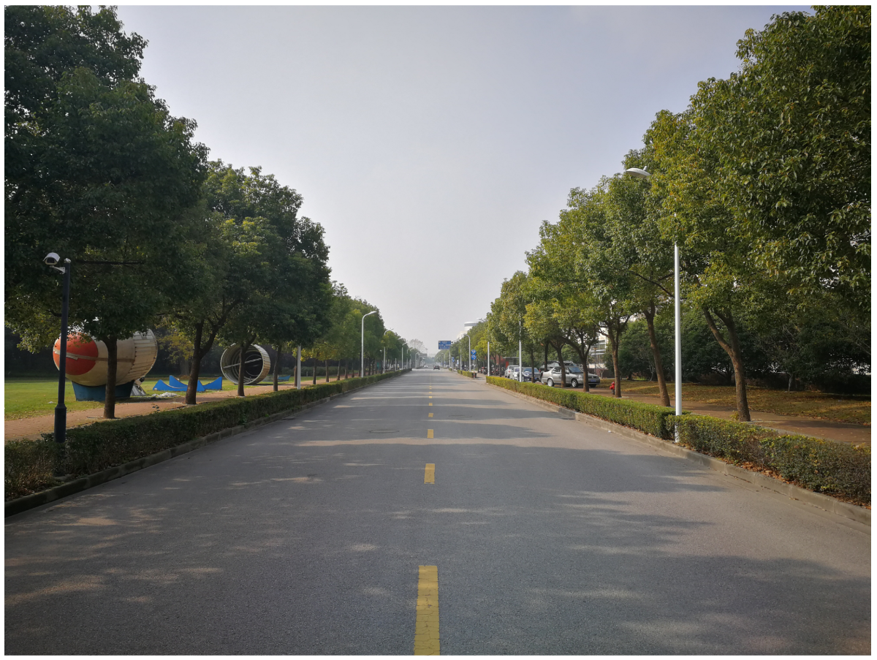
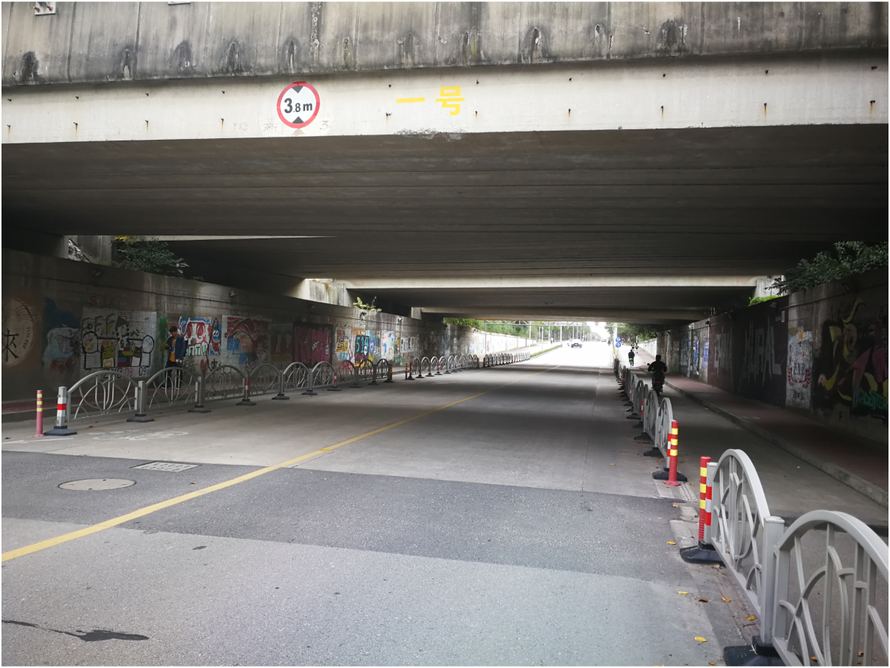
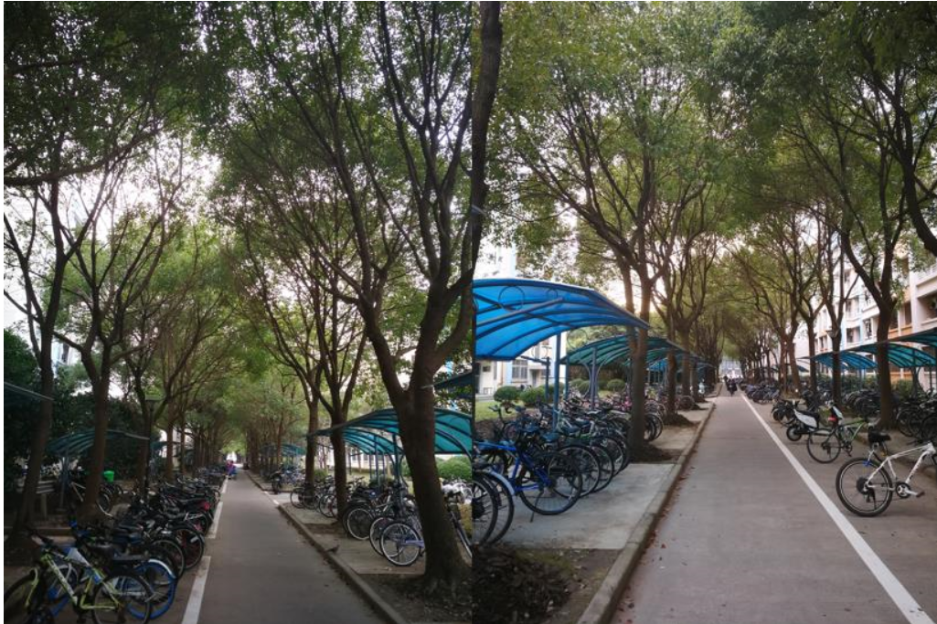
Experiment Setup and Environment
（a）Open filed
(b) Tunnel loop
(c) Shade loop
Experiment environments
HUAWEI P10

Slide 15
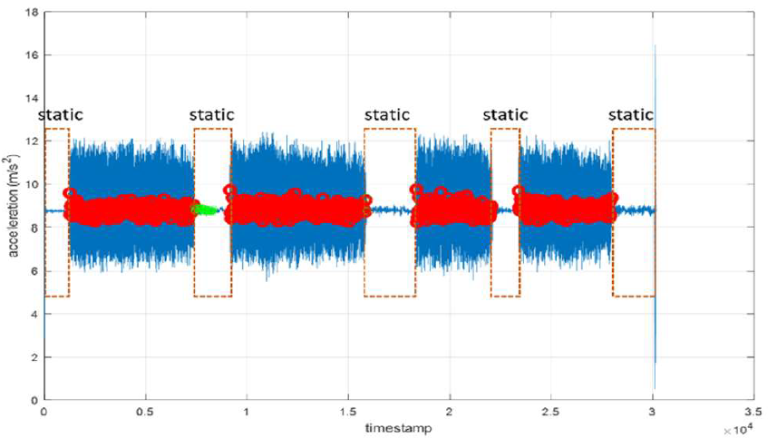
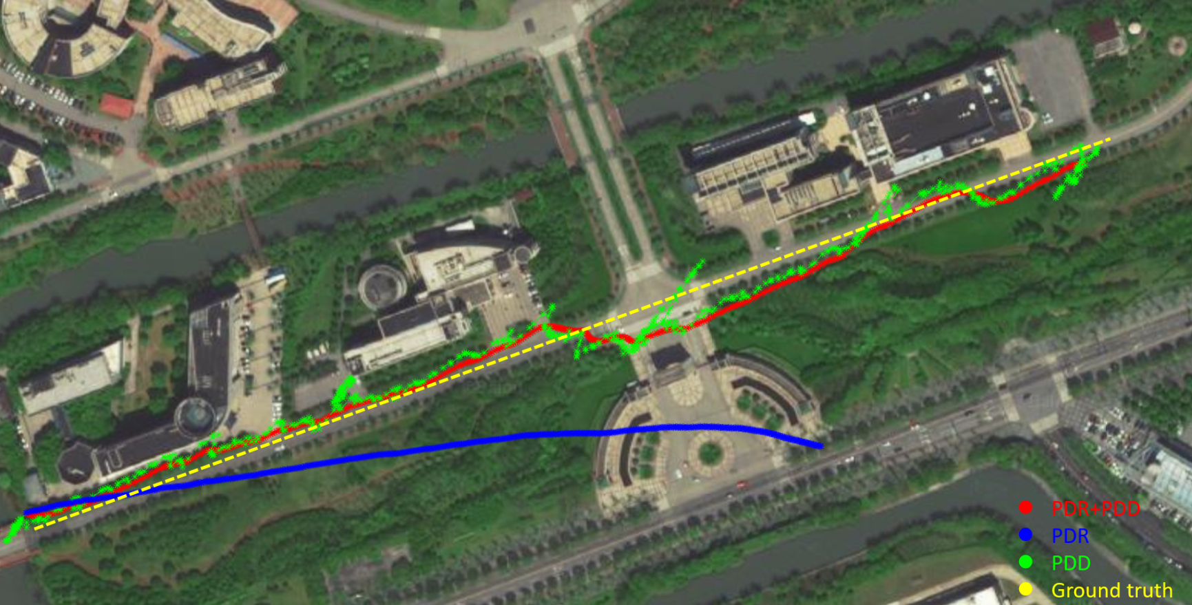
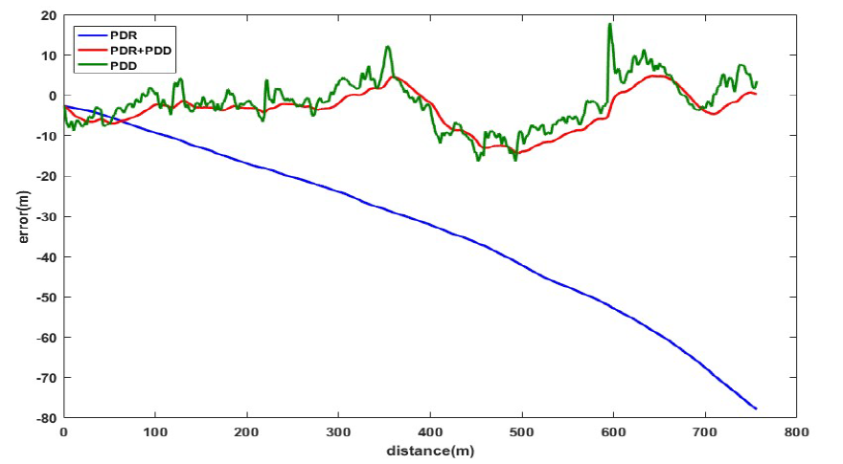
Experiment result
PDR gait estimation
Comparison of trajectories by three method in open filed
Horizontal Error comparison
Notes:
上图中（a）给出了马路的实景照片，路宽度为10
米，路边存在着两排树木以及建筑物，空旷的室外条
件使得可见卫星数以及信号质量都足够提供有效的定
位结果

Slide 16
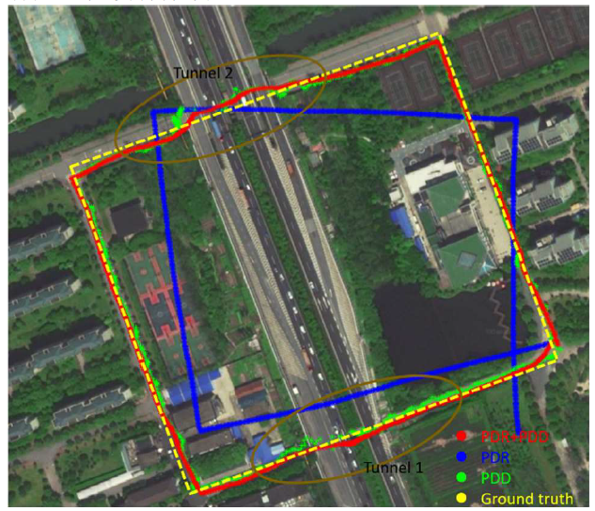
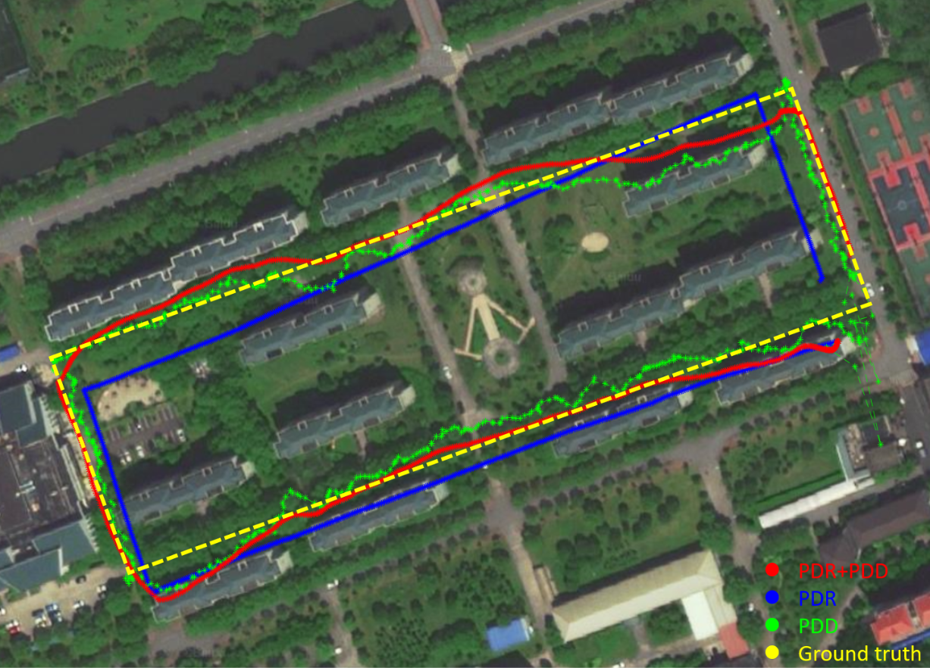
Experiment result
Fusion algorithm compensates the gait lost and heading drift in long time scale.
Trajectories in tunnel loop
Trajectories in shade loop
Notes:
上图中（a）给出了马路的实景照片，路宽度为10
米，路边存在着两排树木以及建筑物，空旷的室外条
件使得可见卫星数以及信号质量都足够提供有效的定
位结果

Slide 17
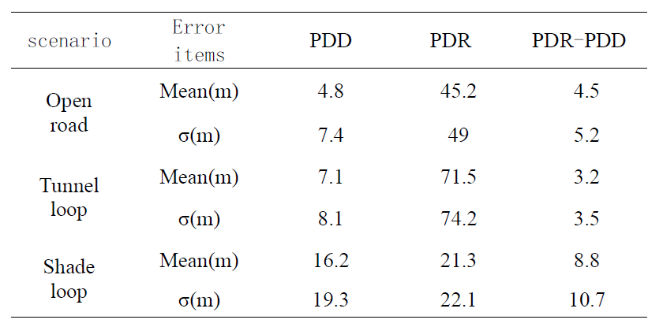
Positioning result
各种条件下实验算法误差
Algorithm results of different experiments

Slide 18
1
Background
2
PDR/GNSS Fusion Framework
3
Experimental Results
4
Conclusion

Slide 19
Conclusion
Data processing：
Promote the pointed pre-processing way based on the smartphone unique signal feature and raw data characteristic.
PDR/GNSS fusion framework：
On the basis of difference GNSS, utilizing the error function on the heading and position layer and real-time feedback to PDR. The key point is the dynamic weight and the choise the error parameters.
Experiment result:
On the condition of dynamic and static alternating motion, short-term signal loss and poor signal quality, the algorithm has its ideal effect. The specified performance that no obvious drift on the scale of 1km, and GNSS signal loss under the tunnel in short time, no error positioning point during the terrible GNSS signal condition. That illustrates in short time scale, the system can play the PDR high-accurate merit, in long time scale, system can calibrate the PDR gain loss and heading drift.

Slide 20


谢 谢 观 赏
THANK YOU

